Slide 1
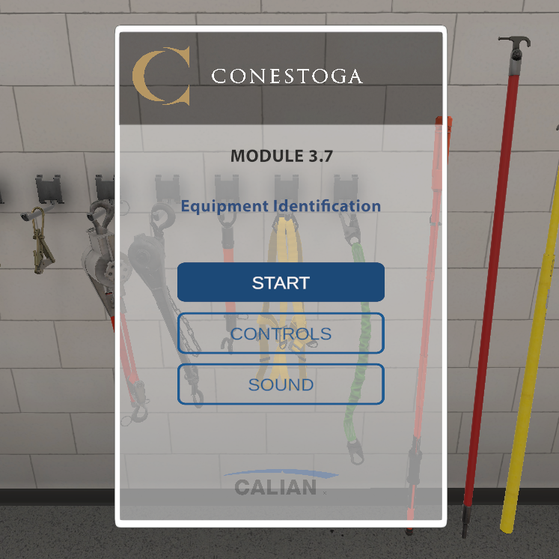
Closing Retro x Powerline
July 2024

Slide 2
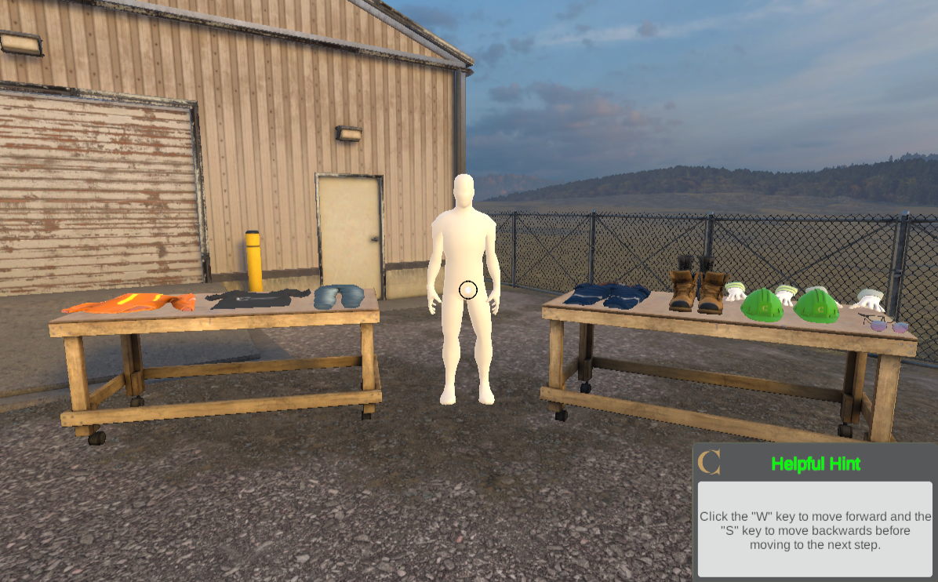
Agenda
Recap
Successes
Challenges
Next Steps
Wrap-Up

Slide 3
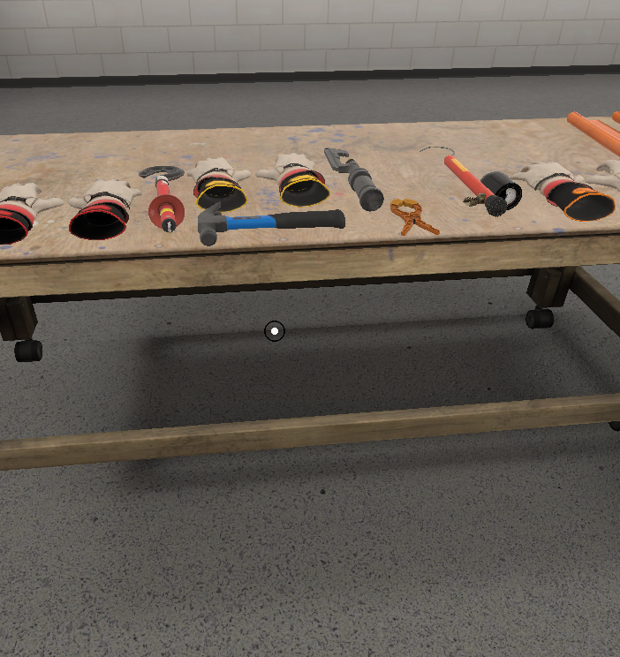
Recap
TRADES & APPRENTICESHIP - POWERLINE TECHNICIAN
Objectives:
Highlight occupational hazards in powerline training
Use virtual reality to familiarize students with processes and safety practices for effective learning and job performance
Description of Modules:
Module 1: Personal Protective Equipment (PPE) – Orientation
Module 2A: Radial Boom Derrick (RBD) Inspection – Procedural
Module 2B: Insulated Aerial Device (IAD) Inspection – Procedural
Module 3.1 - 3.8: Equipment Identification – Orientation
Module 4: Rubber Protective Equipment Practical Application – Procedural
Module 5: Rubber Glove Dead End Insulator Change – Procedural

Slide 4

Successes
Content experts were highly engaged from start to finish, showing great interest throughout
We adjusted the project schedule to allocate time for internal testing of each received build
We negotiated the delivery of alpha and beta versions for each build to enhance quality, rather than testing everything at the final stage
The workflow for uploading builds to eConestoga was streamlined when we implemented LTI integration
Successfully implemented CE's playthroughs
Incorporation of regular instructional design review of build and script
Improved student experience by incorporating helpful hints, captions, ability to repeat instructions, UI design and menu options.
Notes:
Discuss what went well during the project
Identify key challenges or issues encountered

Slide 5

Challenges
Aggressive project schedule - extremely tight and ambitious
Improvements could be made by focusing more on design rather than aesthetics, to enhance the student experience
Advocating for instructional design considerations
Advocating for more time to make ID related decisions
CE time commitment
Testing timeline was too short
Notes:
Discuss what went well during the project
Identify key challenges or issues encountered

Slide 6

Next Steps
Celebrate!
The Powerline Technician program now has 13 distinct digital learning experiences that provide students with learning opportunities that would otherwise be DICE.
What's Next?
Faculty support
Communications
Testing?
SoTL Project?

Slide 7

Wrap Up
Think of each of us as holding a piece of a puzzle. Together, as a team, we piece together the full picture—the project. Each of our contributions makes a big difference
Remember: Stakeholder engagement is key. Engage early, engage often!

Slide 8


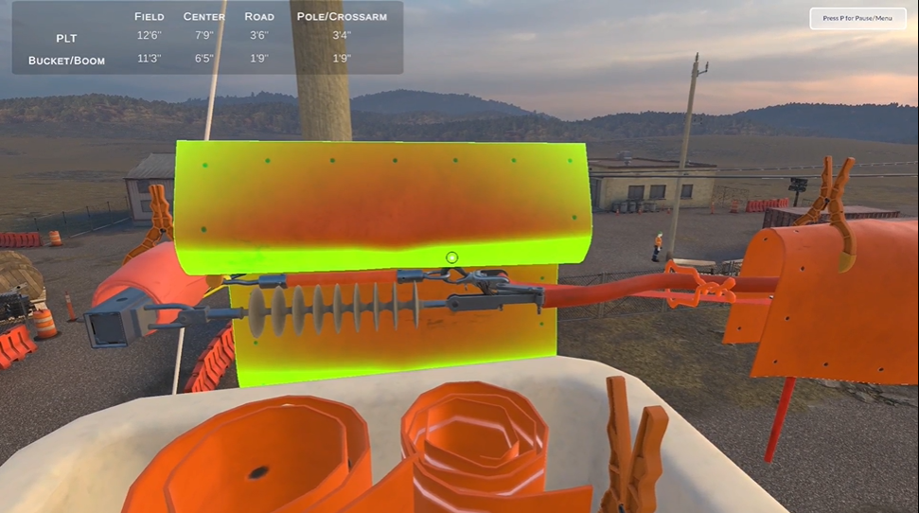
Module Videos

